Slide 1


Slide 2


Faith and AI: the good, the bad and the agathokakological Alin Vrancila CEO of JessupGlobal Founding Partner www.UsefulToGod.com | verumseminary.com

Slide 3

HERO’S JOURNEY

Slide 4

When God does a NEW thing, or we go through something completely outside of our comfort zone:
Hero’s journey step 1:
We need to let go of simplicity… and reductionism

Slide 5

Hero’s journey step 2:
Check to see where God is in your journey!

Slide 6
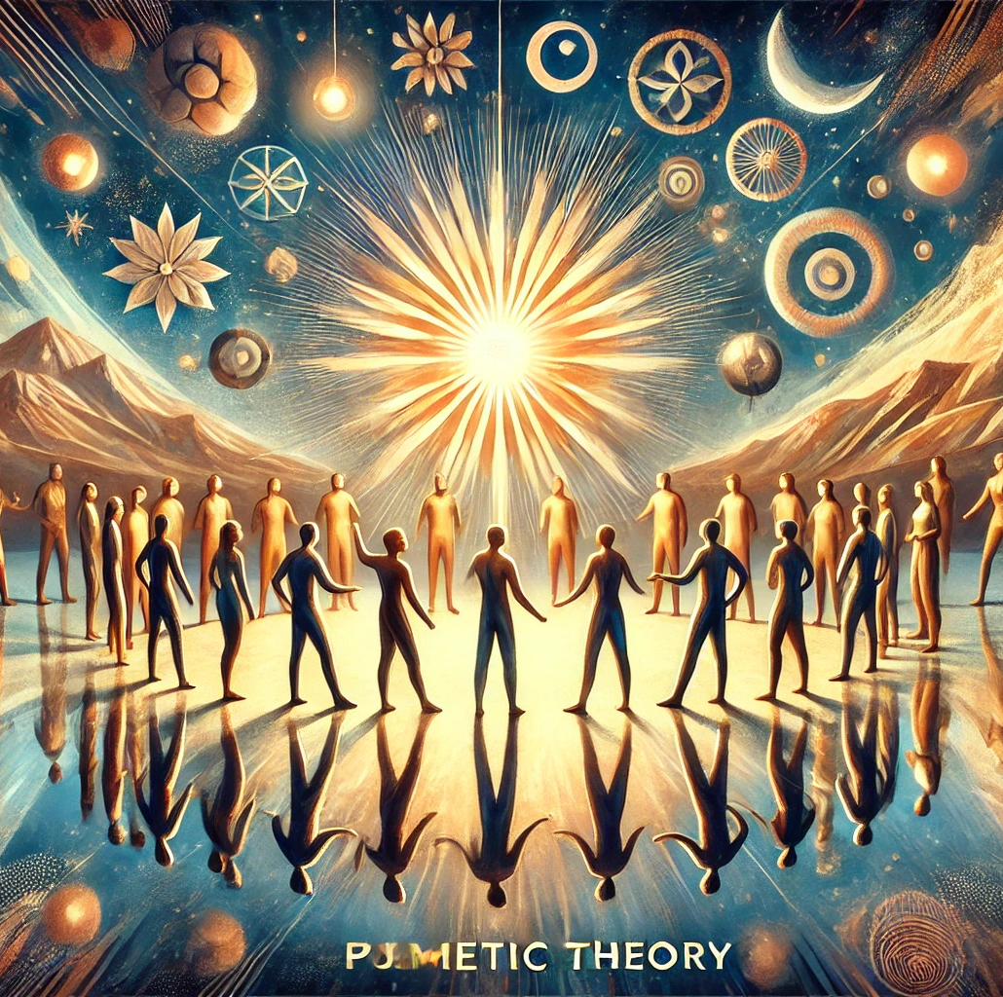
HERO’s Journey Step 3
UNDERSTAND YOUR HIGHER CALLING

Slide 7
HOW DOES THIS APPLY TO YOU?

Slide 8

Q&A

